Slide 1
Decentralized Perception from Online Learning and
Semantic Understanding
Enmao Diao
Eliahu (Ilya) Soloveychik
Vahid Tarokh
Duke University
Durham, NC
02/28/2019

Slide 2
Outline
Introduction
Technical Approach and Discussion of Results
Brief discussion of change detection for multi-regime random fields
Distributed Source Coding
Processing in Compressed domains (without decompression)
Experiments
Ongoing work
Summary and Conclusions

Slide 3
Introduction

Slide 4
Introduction
Distributed nature of machines, processes, and humans will necessitate decentralized processing in order to provide perception of the environment to network of commanders in an intuitive manner.
To provide perception and intuition, sensing, representation, modeling, inference and prediction from random fields are necessary. The issues may include:
representation of mission goals, context and collected data,
effective sensing
effective collection of information,
information fusion
consensus building among different information gathering agents,
identification of gaps in collected data,
effective role allocation and collaboration,
dynamic decision making and control, activity and anomaly recognition,
lifelong learning, etc.

Slide 5
Discussion of Results

Slide 6
Change Detection in Multi-regime Random Fields

Slide 7

Multi-regime Random Fields

Slide 8
Multi-regime Random Fields

Slide 9
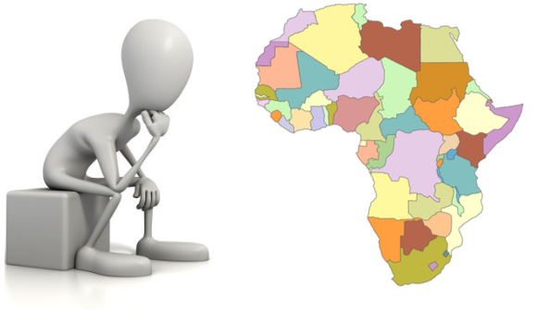
Multi-regime Random Fields

Slide 10
Multi-Regime Random Fields
Key to our approach to sensory understanding of environment has been multi-regime random fields. These capture almost all man-made and natural processes of interest.
We have asked how to provably identify regions of space with similar/distinct data-generating joint statistics (a.k.a. regimes) with limited observations? This is intimately related to modeling.
As a special case we consider the problem of model selection in Gaussian Markov fields and the number of samples sufficient for the consistent detection of all the edges.
We focused on networks embedded into Euclidean spaces; assuming they can be decomposed into homogeneous regions, we develop a novel framework whose target is the detection of these regions.
We have derived lower sample complexity bounds showing that even bounded number of samples is enough for consistent recovery of the regions.

Slide 11
Multi-Regime Random Fields
We proposed a simple greedy algorithm capable of efficiently and reliably partitioning the graph into regions and rigorously analyze its performance [5]
We supported our study by synthetic and real data simulations [5].
The proof relates to some recent deep developments in mathematics namely Vershik’s Theory and its large deviation version [1,2,3] [4].
[1] A. M. Vershik. A statistical sum associated with Young diagrams. Zapiski Nauchnykh Seminarov POMI, 164:20–29, 1987.
[2] A. M. Vershik. The limit shape of convex lattice polygons and related topics. Functional Analysis and Its Applications, 28(1):13–20, 1994.
[3] M. Vershik and O. Zeitouni. Large deviations in the geometry of convex lattice polygons. Israel Journal of Mathematics, 109(1):13–27, 1999.
[4] Eliahu (Ilya) Soloveychik and Vahid Tarokh, Region Detection in Markov Random Fields: Gaussian Case, submitted
[5] Eliahu (Ilya) Soloveychik and Vahid Tarokh, Stationary Geometric Graphical Model Selection, submitted

Slide 12
Distributed Source Coding

Slide 13
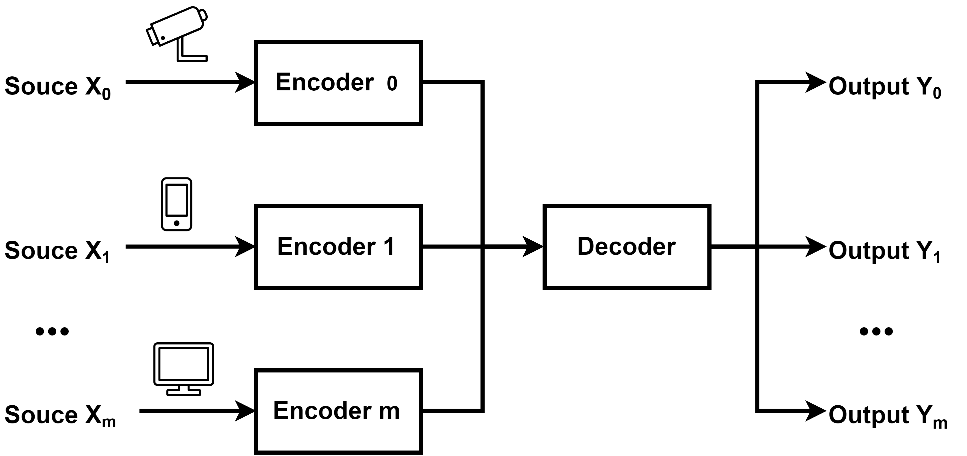
Distributed Source Coding (DSC)
A decoder would like to reconstruct observations at various sensors/cameras with minimal communications.
This was also pointed out by Dr. McKenna (issue of limited communications constraints in Naval settings) in his presentation.
Interestingly, yesterday Dr. McKenna pointed out the issue of limited communications constraints in Naval settings in his presentation.

Slide 14
Slepian-Wolf Theorem
Key theoretical result is due to Slepian and Wolf (SW).
Source X
Encoder X
X
Joint
Decoder
Y
Source Y
Encoder Y

Slide 15
Slepian-Wolf Theorem
Sources are i.i.d. (not realistic)
They know their joint statistics (not fully realistic)
Lossless Compression (not of interest in most cases)
They do not know each other’s outcome
Separate encoding and decoding of X and Y
Separate encoding and joint decoding of X and Y

Slide 16
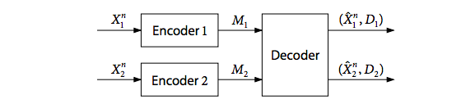
Lossy Distributed Source Coding
Slepian-Wolf Theorem is for lossless source coding.
Distributed source coding with lossy sources is not a fully solved problem even for IID sources.

Slide 17
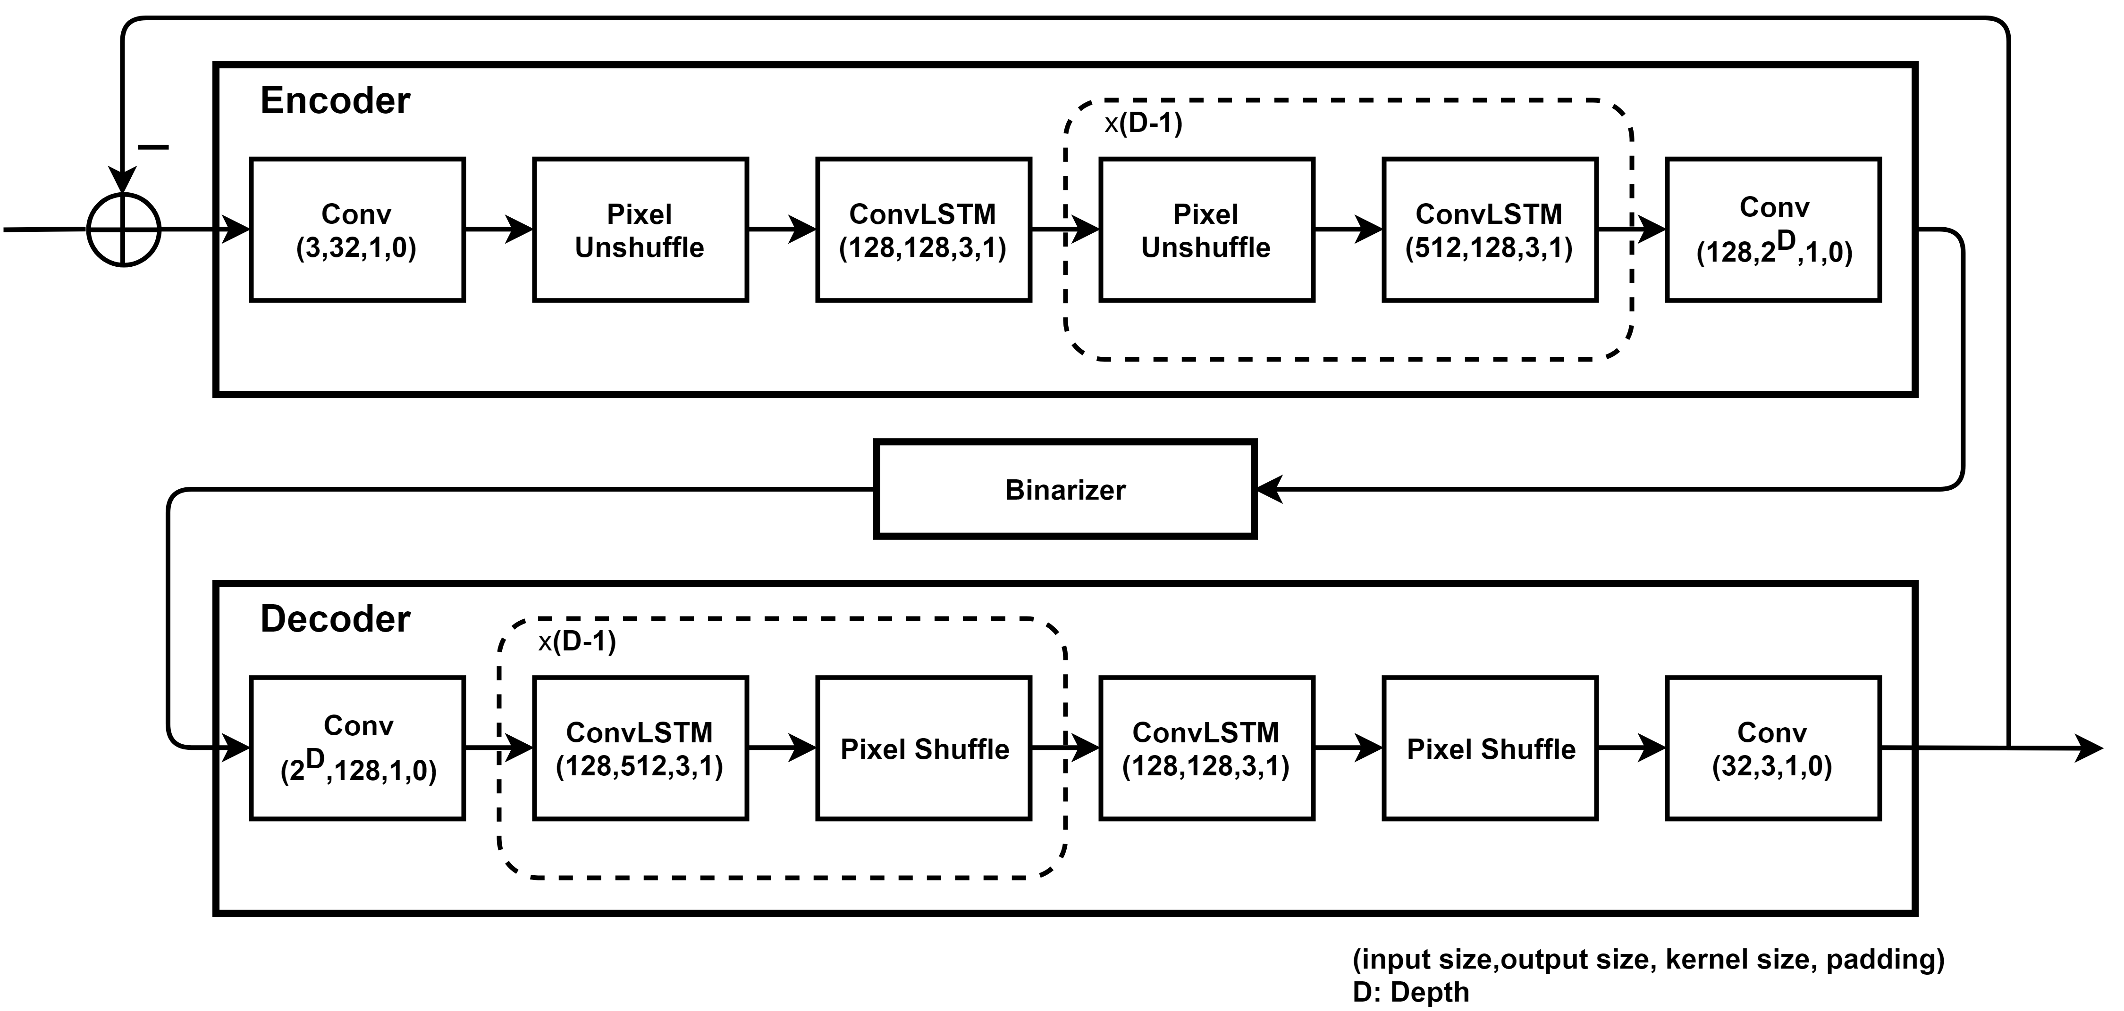
Deep Slepian-Wolf Architecture
Compression Module
Variable compression quality
The difference of input and reconstructed output are fed into the network at each iteration to generate codes. Compression quality can be controlled by the number of iterations

Slide 18
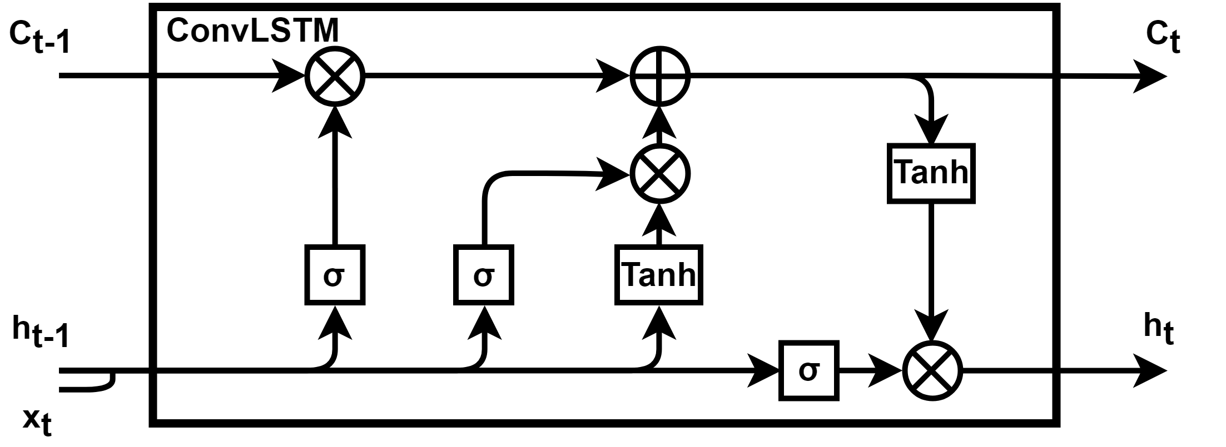
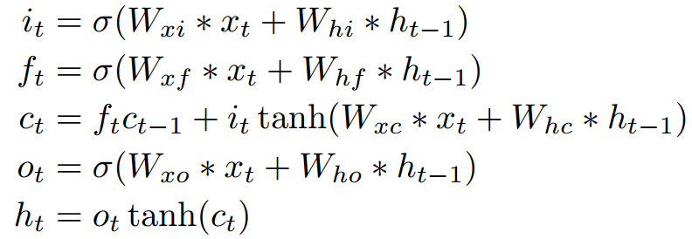
Convolutional LSTM
Compression Module
Convolutional LSTM
Replace Linear module in Long short term memory (LSTM) with Convolution module

Slide 19
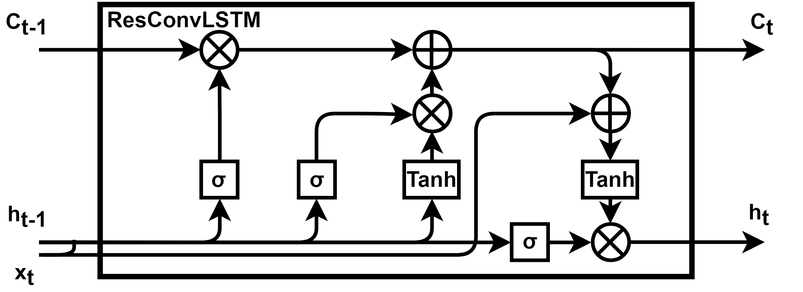
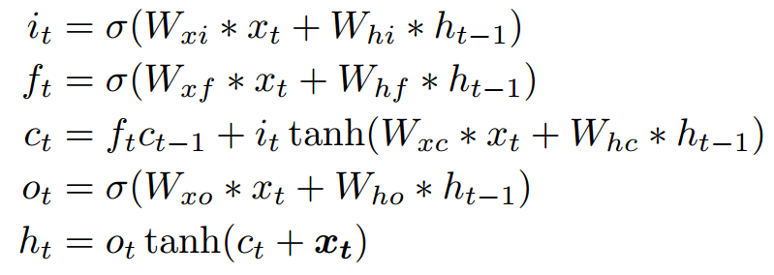
Residual Convolutional LSTM
Compression Module
Residual convolutional LSTM
Residual Convolutional LSTM is free of gradient vanishing and makes it possible to create deeper network and yield better performance
[6]
[6] Kaiming He, Xiangyu Zhang, Shaoqing Ren, and Jian Sun, Deep Residual Learning for Image Recognition.

Slide 20
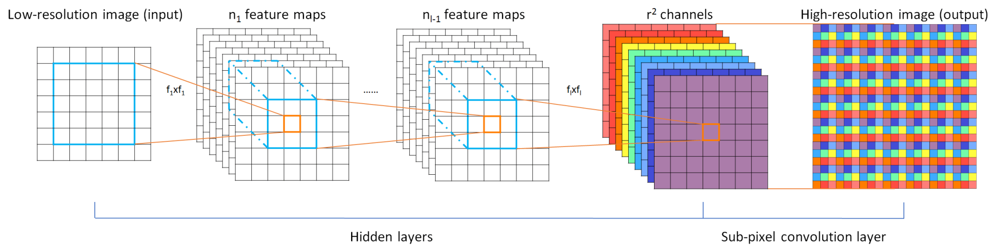
Deep Slepian-Wolf Architecture
Compression Module
Pixel UnShuffle is the inverse of pixel shuffle [7]
Compare to interpolation and convolution with different strides, pixel shuffle module is a non parametric (up)downsample module that is very easy to implement and computationally efficient
The shortcoming is we need many channels and downsample ratio has to be the power of 2
Reshape matrix
Pixel Unshuffle by factor of 2
(N,C,H,W) -> (N,4C,H/2,W/2)
Pixel Shuffle by factor of 2
(N,C,H,W) -> (N,C/4,2H,2W)
[7] Ledig, Christian, et al. "Photo-realistic single image super-resolution using a generative adversarial network." Proceedings of the IEEE conference on computer vision and pattern recognition. 2017.

Slide 21
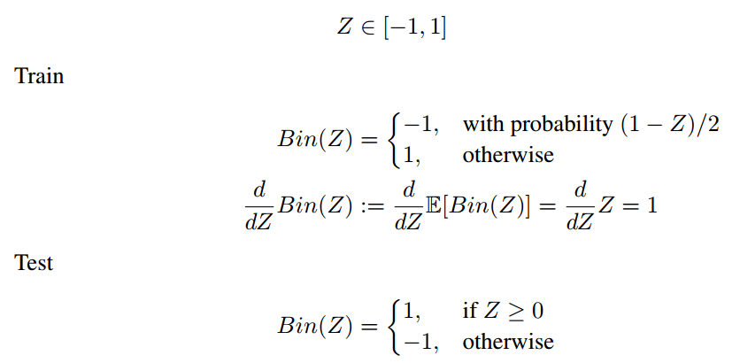
Deep Slepian-Wolf Architecture
Compression Module
Binarizer
Images are down-sampled from (3,32,32) to (8,4,4). The input of binarizer is in the range [-1,1] due to tanh(.) activation. Each element in the tensor is binarized with following equations. To approximate the noise from the quantization, we use a stochastic form of binarization during training.
[8] Theis, Lucas, et al. "Lossy image compression with compressive autoencoders." arXiv preprint arXiv:1703.00395 (2017).
[9] Toderici, George, et al. "Full resolution image compression with recurrent neural networks." Proceedings of the IEEE Conference on Computer Vision and Pattern Recognition. 2017.
[8,9]

Slide 22
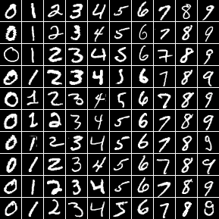
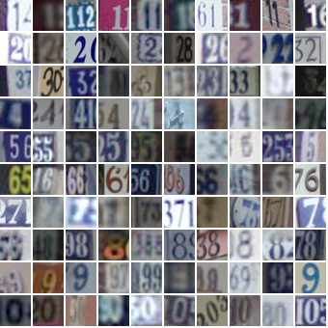
Test Data
Dataset
MNIST dataset
60000 handwritten 0-9 digits images for training, 10000 digits for testing, resized to 32x32
SVHN dataset
Street View House Numbers data containing 0-9 digits RGB cropped images. 73257 digits for training, 26032 digits for testing

Slide 23
Experiment
Distributed Source Coding
Experiment Specification
Training data are split into multiple subsets and each encoder only has access to one specific subset. We make sure no data are shared among those encoders.
We train with Stochastic Gradient Descent of batch size 100. We run 200 Epochs at learning rate 0.001 with Adam Optimizer.
The difference between the input image and reconstructed image is used at next iteration. Each iteration we accumulate 128 bits from one 32x32 image. We iterate 16 times and achieve 2 Bit Per Pixel (BPP) as total. The reconstructed image is the summation of reconstructed outputs of each iteration.
Further compression can be achieved with entropy coding but this was not attempted in the simulations.
We use L₁ Loss for reconstruction and measure PSNR vs. BPP.

Slide 24
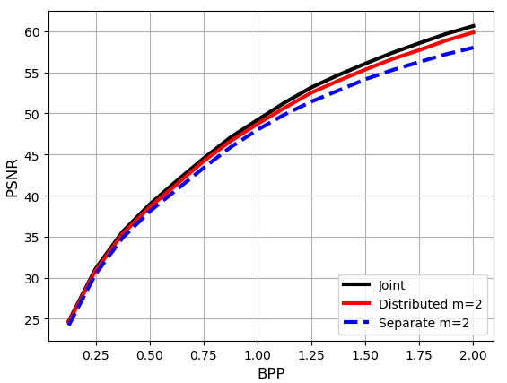
Experiment
Distributed Source Coding
We train on (2, 4, 8) number of encoders separately (separate) and one single decoder jointly (distributed). We compare the result to train the (2, 4, 8) number of encoders and decoders separately, and to one encoder, one decoder setting with the same amount compression (joint).
Each encoder is trained with subset of data inverse proportional to the number of encoders and tested with all test data separately. The result is averaged over all encoders

Slide 25
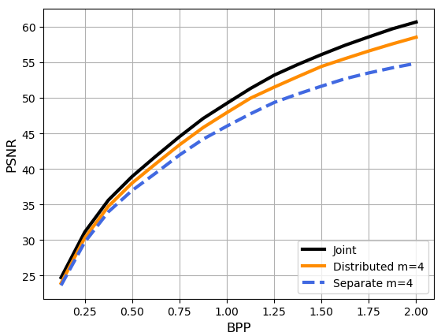
Experiment
Distributed Source Coding
We train on (2, 4, 8) number of encoders separately (separate) and one single decoder jointly (distributed). We compare the result to train the (2, 4, 8) number of encoders and decoders separately, and to one encoder, one decoder setting with the same amount compression (joint).
Each encoder is trained with subset of data inverse proportional to the number of encoders and tested with all test data separately. The result is averaged over all encoders

Slide 26
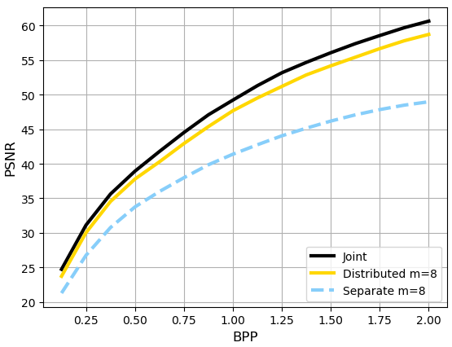
Experiment
Distributed Source Coding
We train on (2, 4, 8) number of encoders separately (separate) and one single decoder jointly (distributed). We compare the result to train the (2, 4, 8) number of encoders and decoders separately, and to one encoder, one decoder setting with the same amount compression (joint).
Each encoder is trained with subset of data inverse proportional to the number of encoders and tested with all test data separately. The result is averaged over all encoders

Slide 27
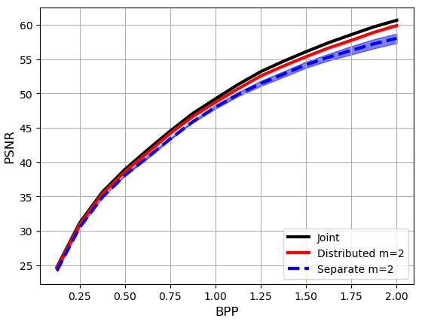
Experiment
Distributed Source Coding
Although our distributed encoders do not share parameters but the joint decoder compute gradients over all compressed data. Therefore, each encoder can benefit from other input images without directly communicate with other encoders
The performance band is plot from the best and worst possible performance of all encoders. Our result is very robust against hijacking and blockage

Slide 28
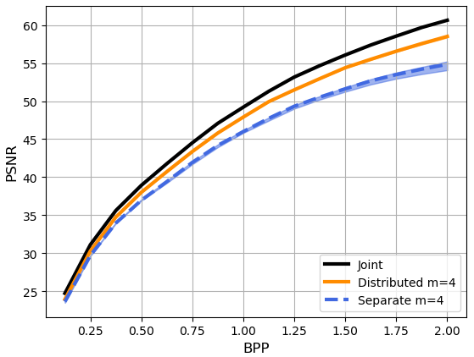
Experiment
Distributed Source Coding
Although our distributed encoders do not share parameters but the joint decoder compute gradients over all compressed data. Therefore, each encoder can benefit from other input images without directly communicate with other encoders
The performance band is plot from the best and worst possible performance of all encoders. Our result is very robust against hijacking and blockage

Slide 29
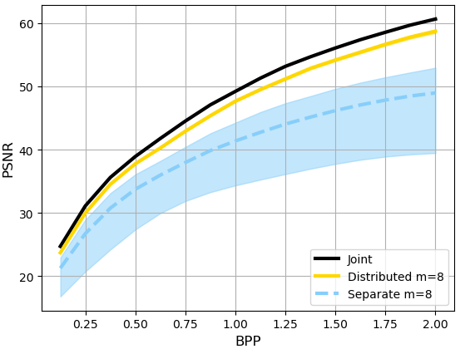
Experiment
Distributed Source Coding
Although our distributed encoders do not share parameters but the joint decoder compute gradients over all compressed data. Therefore, each encoder can benefit from other input images without directly communicate with other encoders
The performance band is plot from the best and worst possible performance of all encoders. Our result is very robust against hijacking and blockage

Slide 30
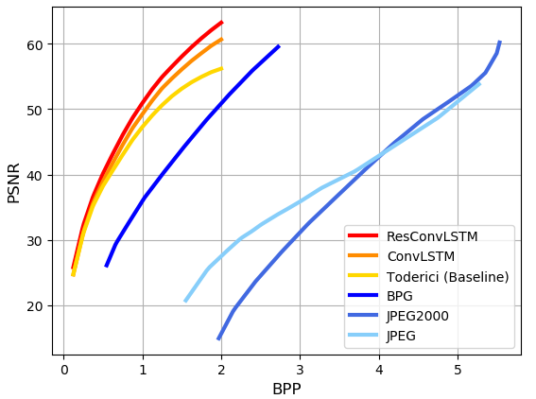
Experiment
Distributed Source Coding
We also compare the performance of joint training codec with classical codecs like JPEG and BPG. Our results outperform classical codecs and previous works on Image Compression with Deep Learning proposed by Google
[9] Toderici, George, et al. "Full resolution image compression with recurrent neural networks." Proceedings of the IEEE Conference on Computer Vision and Pattern Recognition. 2017.

Slide 31
Ongoing work
Distributed Source Coding
Experiment Specification
Training data are split into multiple subsets by classes and each encoder only has access to one specific class of subset. We make sure no data are shared among those encoders.
We train with Stochastic Gradient Descent of batch size 100. We run 200 Epochs at learning rate 0.001 with Adam Optimizer.
The difference between the input image and reconstructed image is used at next iteration. Each iteration we accumulate 128 bits from one 32x32 image. We iterate 16 times and achieve 2 Bit Per Pixel (BPP) as total. The reconstructed image is the summation of reconstructed outputs of each iteration.
We use L₁ Loss for reconstruction and measure PSNR vs. BPP.

Slide 32
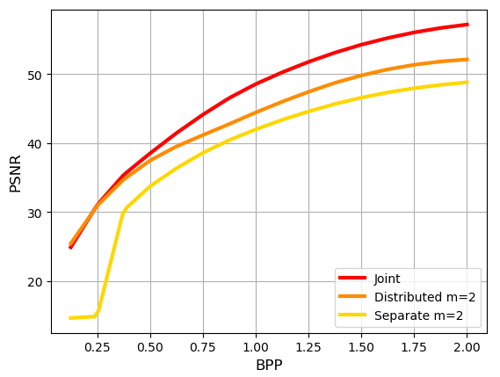
Ongoing work
Distributed Source Coding
We train two encoders and they have access to the data of digit 0 and digit 1 respectively. We compare the results among single encoder and decoder (joint), two distributed encoders and one single decoder (distributed), and two separate encoders and decoders (separate)

Slide 33
Classification Based on Compressed Data

Slide 34
High Resolution Cameras
High resolution video cameras with Gigapixels per frame are becoming widespread.
One can see photographs and videos with resolutions of 0.01 inch below: https://viewer.gigamacro.com/view/7np5k3kKlOYgxqiE?x1=4098220.87&y1=4925299.09&res1=0.78&rot1=0.00
For detecting changes, modeling, representation, etc. in distributed setting, it may not be possible/energy efficient to transmit the entire data to a processing center.
This was also pointed out by Dr. McKenna (issue of limited communications constraints in Naval settings) in his presentation.
Also, it may not be energy efficient to decompress the data and process it for signals of interest.
Decentralized perception can be more efficient if a coarse processing of compressed data is performed first. Up on suspecting a signal of interest, full resolution data can be either communicated or full decompression can be performed.

Slide 35
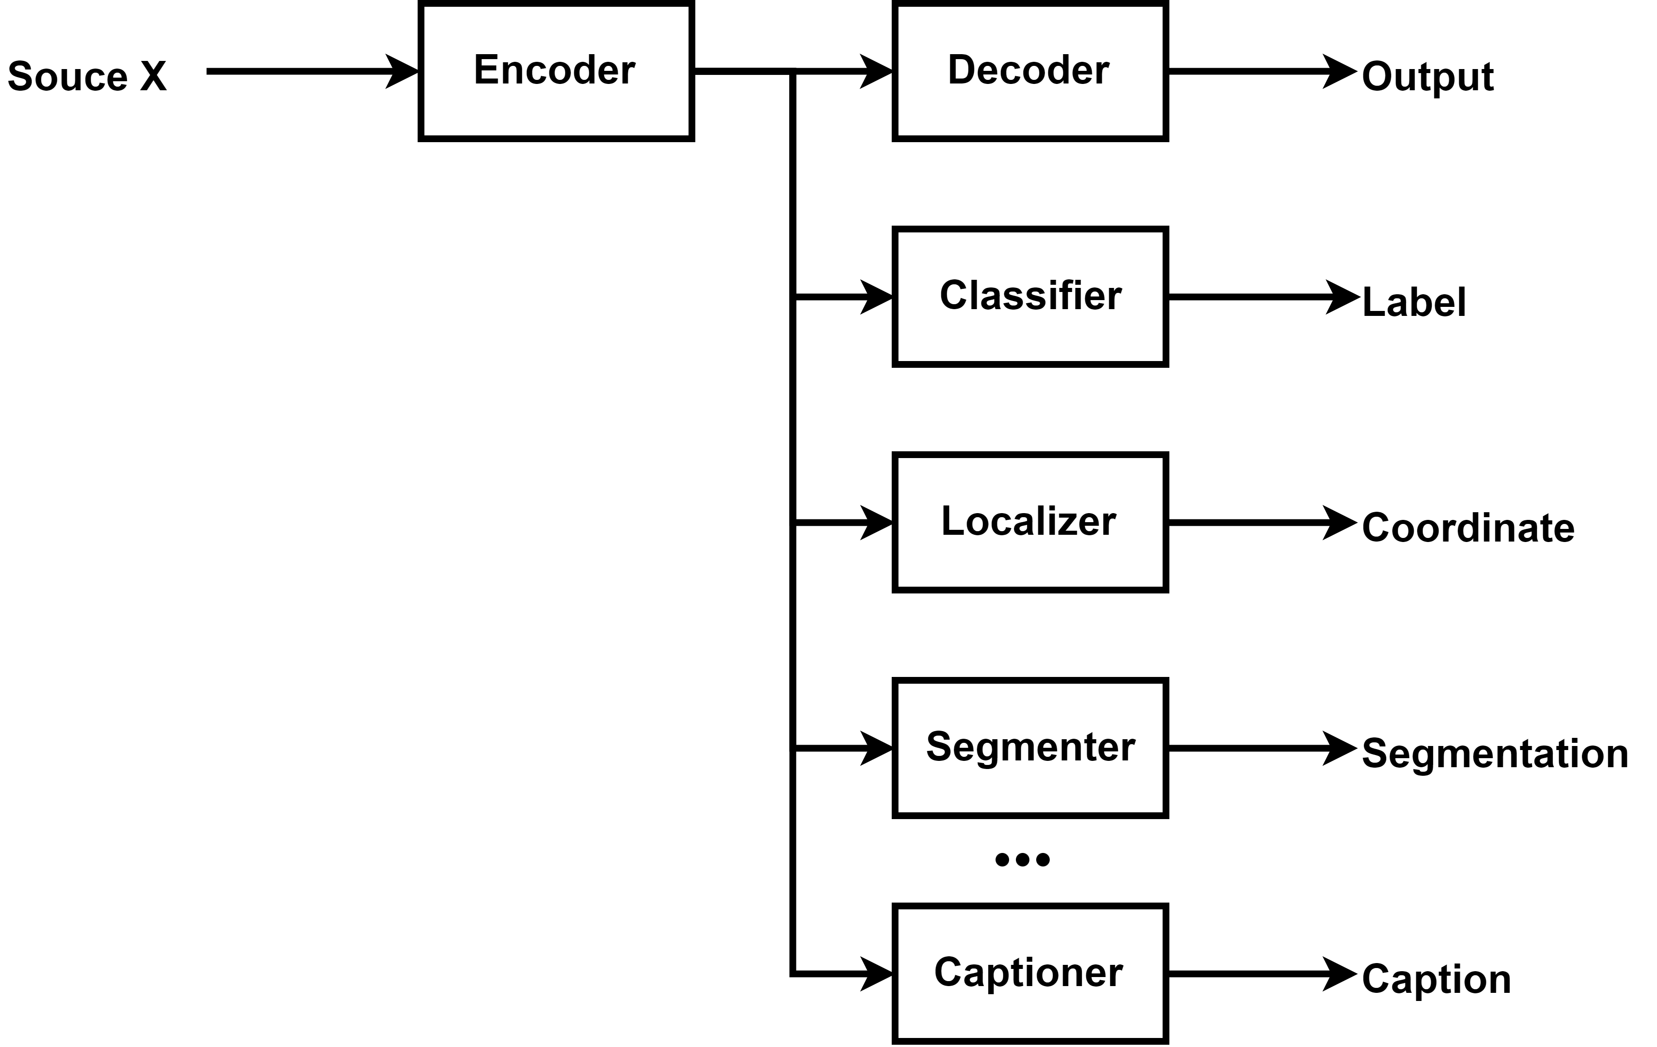
Framework
Image Classification based on compressed domain
In a band-limited scenario, highly compressed codes are transmitted and used for different tasks

Slide 36
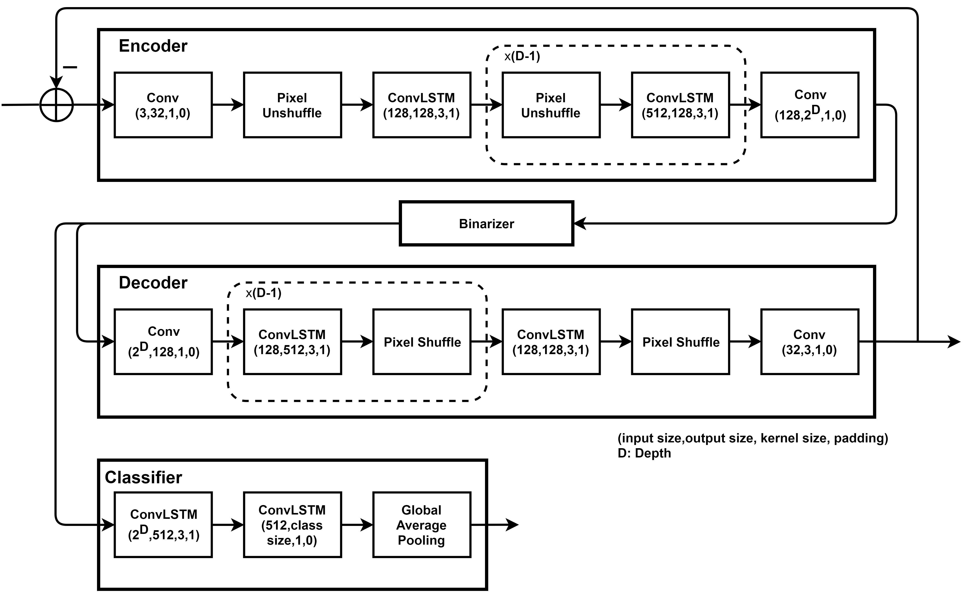
Architecture
Classification Module
Variable classification performance
More codes can achieve better classification performance. User can control this trade-off after receiving the codes

Slide 37
Architecture
Dataset
MNIST dataset
60000 handwritten 0-9 digits images for training, 10000 digits for testing, resized to 32x32
SVHN dataset
Street View House Numbers data containing 0-9 digits RGB cropped images. 73257 digits for training, 26032 digits for testing

Slide 38
Experiment
Classification Based on Compressed Data
Experiment Specification
We train with Stochastic Gradient Descent of batch size 100. We run 200 Epochs at learning rate 0.001 with Adam Optimizer.
The difference between the input image and reconstructed image is used at next iteration. Each iteration we accumulate 128 bits from one 32x32 image. We iterate 16 times and gain 2 Bit Per Pixel as total.
The outputs of classifier over each iteration are accumulated and the predicted probability at each iteration is equal to softmax(.) of these accumulated results.
We jointly optimize reconstruction and classification loss. We use L₁ Loss for reconstruction and Cross Entropy Loss for classification. We do not fine tune the balancing weight between reconstruction and classification loss. We can enhance classification performance by attenuating reconstruction performance. We measure PSNR vs. BPP, Accuracy vs. BPP and ROC vs. BPP.

Slide 39
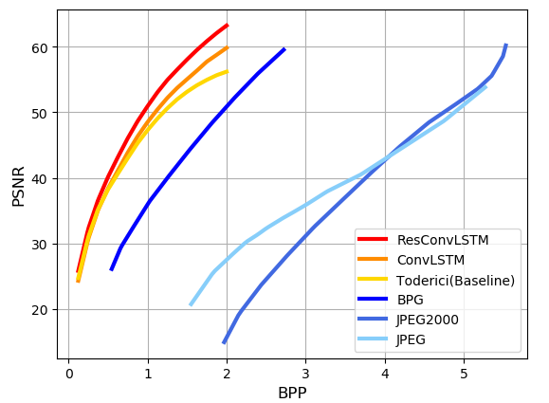
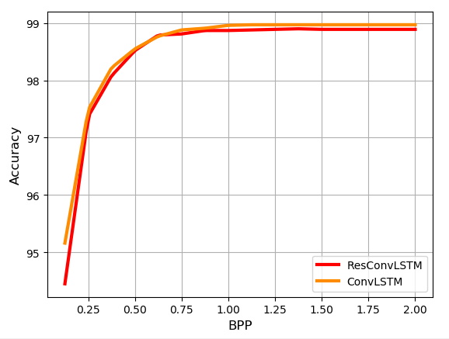
Experiment
Classification Based on Compressed Data (MNIST)
We also compare the performance of joint training codec with classical codecs like JPEG and BPG. Our results outperform classical codecs and previous works on Image Compression with Deep Learning proposed by Google. Our model can perform compression and classification at the same time.
[9] Toderici, George, et al. "Full resolution image compression with recurrent neural networks." Proceedings of the IEEE Conference on Computer Vision and Pattern Recognition. 2017.

Slide 40
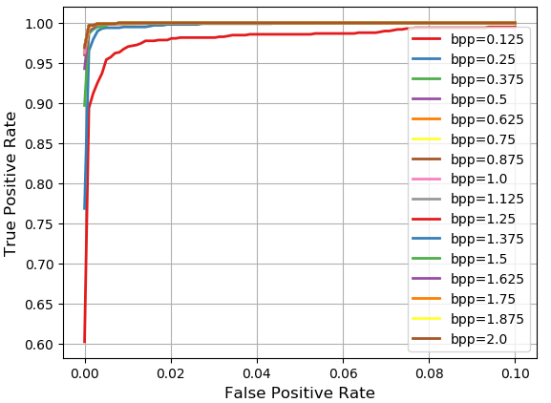
Experiment
Classification Based on Compressed Data (MNIST)
We show ROC curve of our classifier with Convolutional LSTM module across different BPP

Slide 41
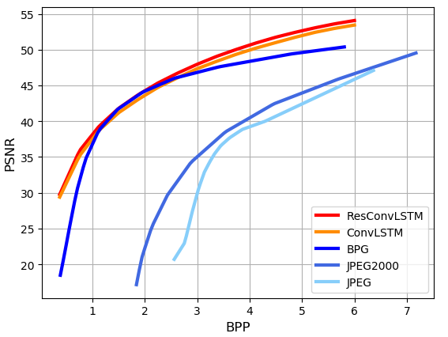
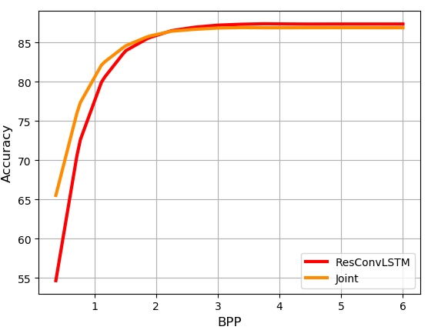
Experiment
Classification Based on Compressed Data (SVHN)
We also compare the performance of joint training codec with classical codecs like JPEG and BPG. Our results outperform classical codecs and previous works on Image Compression with Deep Learning proposed by Google. Our model can perform compression and classification at the same time.

Slide 42
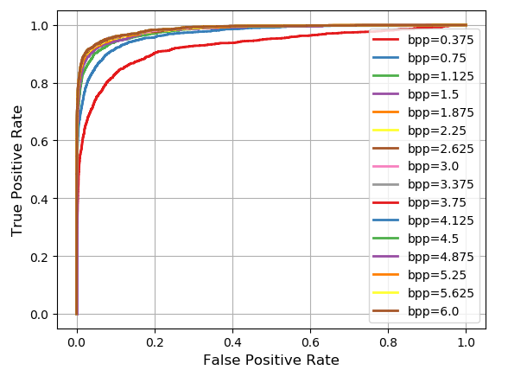
Experiment
Classification Based on Compressed Data (SVHN)
We show ROC curve of our classifier with Convolutional LSTM module across different BPP

Slide 43
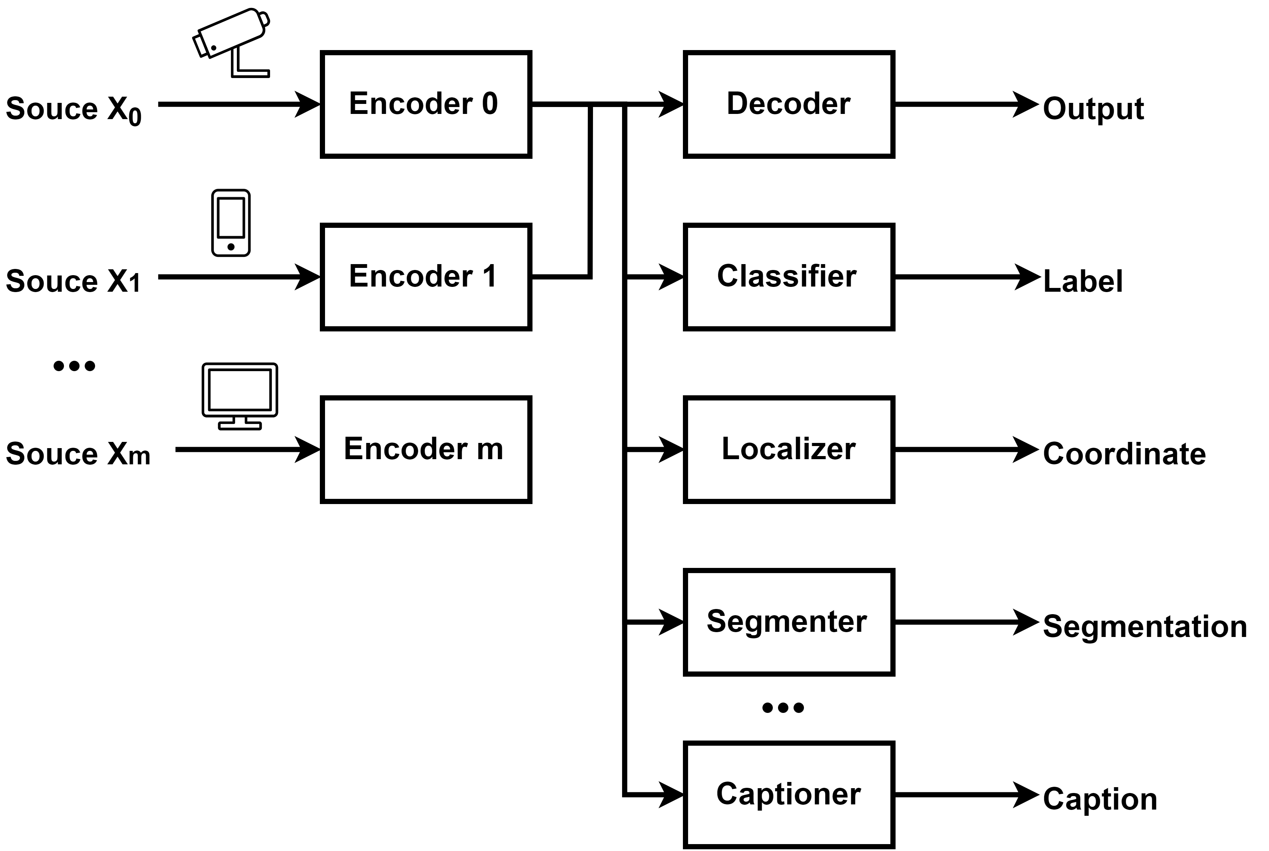
Ongoing work
Distributed classification (on compressed domain)
Combine classification on compressed domain and Distributed Source Coding
Distributed classification
Distributed feature extraction CNNs and one joint classifier
No need to share parameters of layers before the bottleneck layer
Possible large batch size training due to non-shared parameters
Optimize joint classifier with Quasi-Newton optimizer

Slide 44
Ongoing work
Extending the Multi-regime Random results to modeling, prediction, causality calculation, context building, etc. directions.
Image detection, segmentation, localization and Caption on compressed Domain
Low-complexity distributed encoding and decoding
Demonstration of our theories in practice

Slide 45
Summary
Developed regime change detection theories/algorithms for multi-regime random fields.
Proposed a framework for performing image classification and other tasks on compressed domain
Proposed a framework for realizing Slepian-Wolf Theorem with Deep Learning model
We show distributed encoders and joint decoder has dominant advantage over independent trained codecs
Demonstrated the robustness of our framework in the above.
As a byproduct, our result produced a data-driven image codec that outperforms classical codecs.

Slide 46
Thank You

